Slide 1

Team Details
a. Team name: Tech Pirates
Team leader name: Kunal Ambelkar
Problem Statement: Open Innovation
Theme : Leveraging the power of AI

Slide 2

Problem statement and Solution
Problem Statement: Many people grow plants at home or on farms but struggle to identify plant species and detect diseases at an early stage. Incorrect identification and lack of timely care often lead to poor plant health and reduced yield.
Solution: Our solution is an AI-powered web application where users upload an image of a plant. The system identifies the plant species, detects possible diseases using Google Gemini, and provides personalized plant care tips. This helps users take quick and informed action to maintain healthy plants.

Slide 3
Opportunities
How is it different from existing ideas?
                Combines plant identification, disease detection, and care suggestions in one platform
        Uses Google Gemini for intelligent image understanding and reasoning
        Simple web-based solution, no expert knowledge required
    b. How does it solve the problem?
Early disease detection reduces plant damage
Accurate identification improves plant care decisions
Easy accessibility helps farmers, gardeners, and students

Slide 4
List of features offered
Upload plant image through web interface
Automatic plant species identification
Detection of visible plant diseases
AI-generated plant care and treatment suggestions
User-friendly and responsive website design
Fast results with minimal user input

Slide 5
Google Technologies used in this solution
Google Gemini API – Image analysis and disease identification

Slide 6
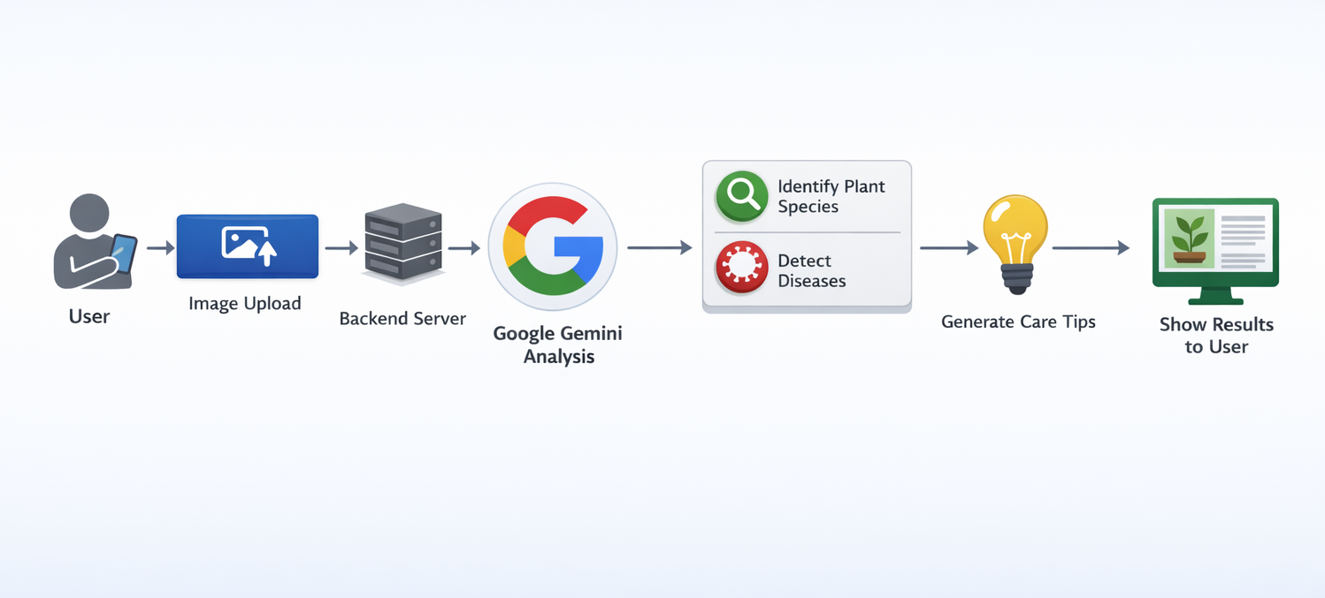
Process flow diagram

Slide 7
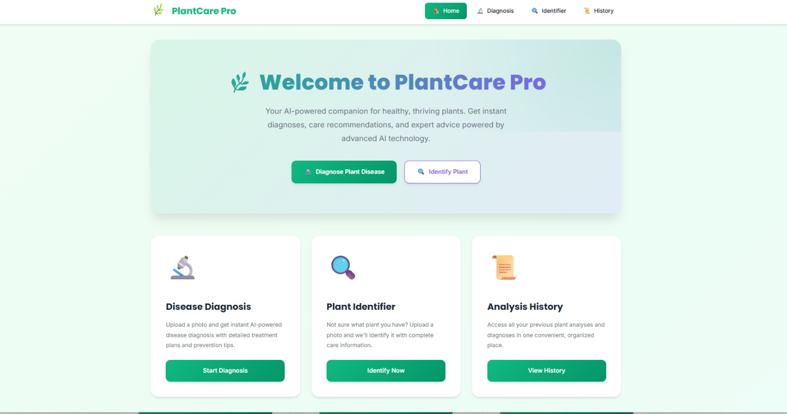
Wireframes/Mock diagrams

Slide 8
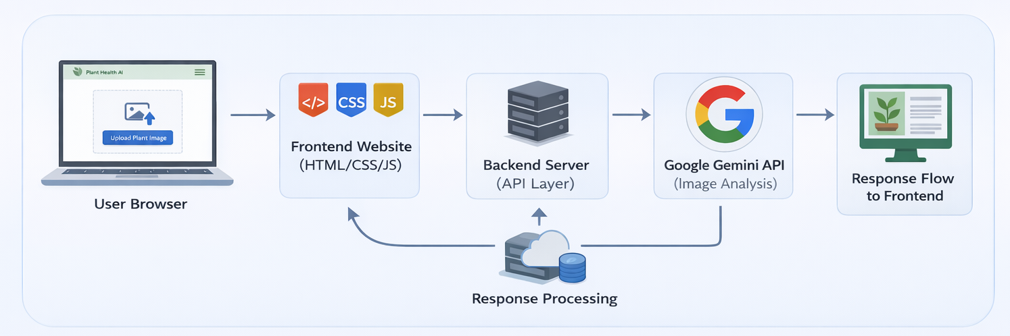
Architecture diagram

Slide 9
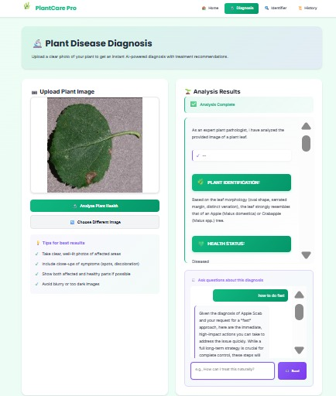
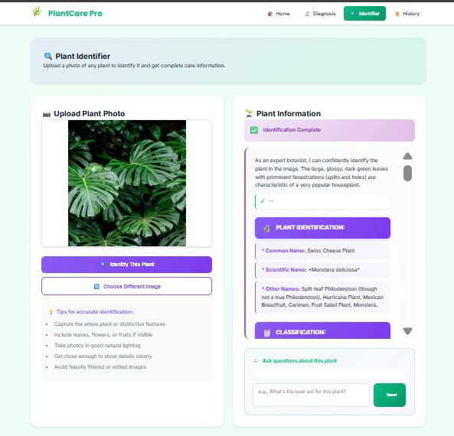
Snapshots of this MVP

Slide 10
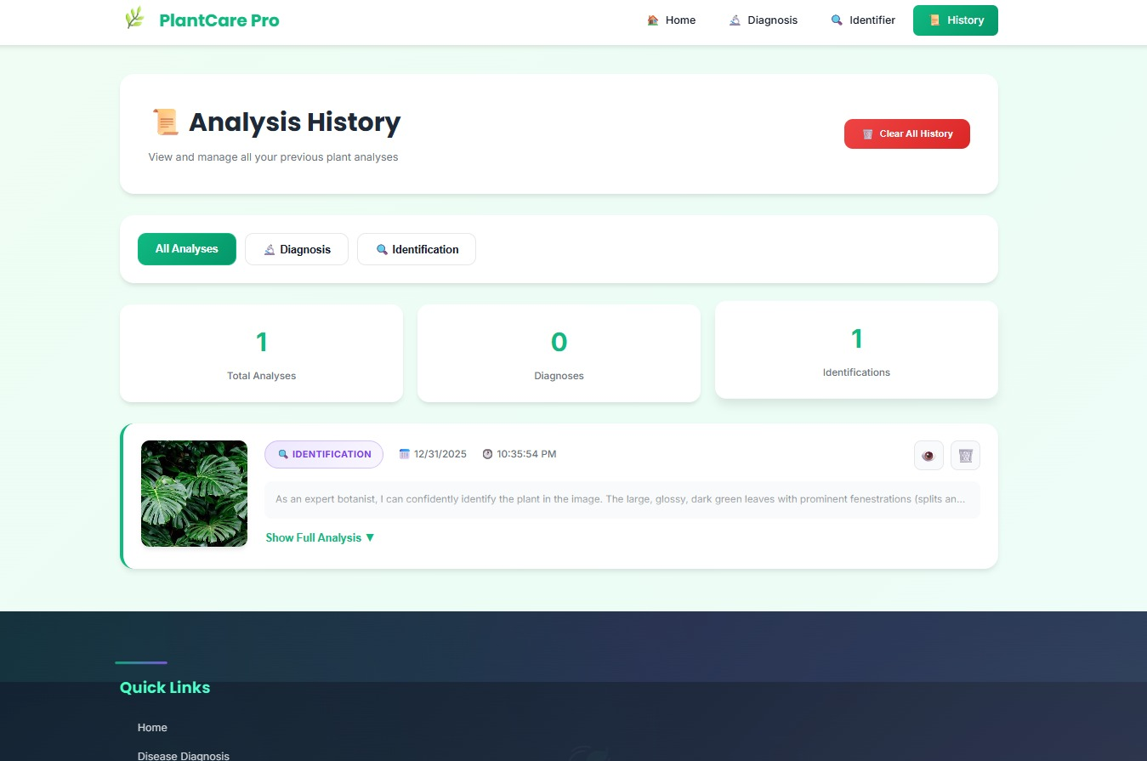
Snapshots of this MVP

Slide 11
Additional Details/Future Development
Support for multiple plant images at once
Multilingual plant care recommendations
Mobile app version of the platform
Integration with weather data for better care advice
Community feature for sharing plant health experiences

Slide 12
Links:
https://github.com/kunal25510/Plant_care.git
https://drive.google.com/drive/folders/1i1FH1KN2nkWavoBwkmKmfFrGwn3_LJq-
MVP Link:

Slide 13
Thank You!

